Slide 1
RC Car
Joe Wroe
Eric Junkins
Jean-Christophe
Vilok

Slide 2
Complete Sprints
Figured out signals that steering and throttle control send to motor
Basic App layout and design
Basic App Bluetooth compatibility

Slide 3

Servo Demo

Slide 4
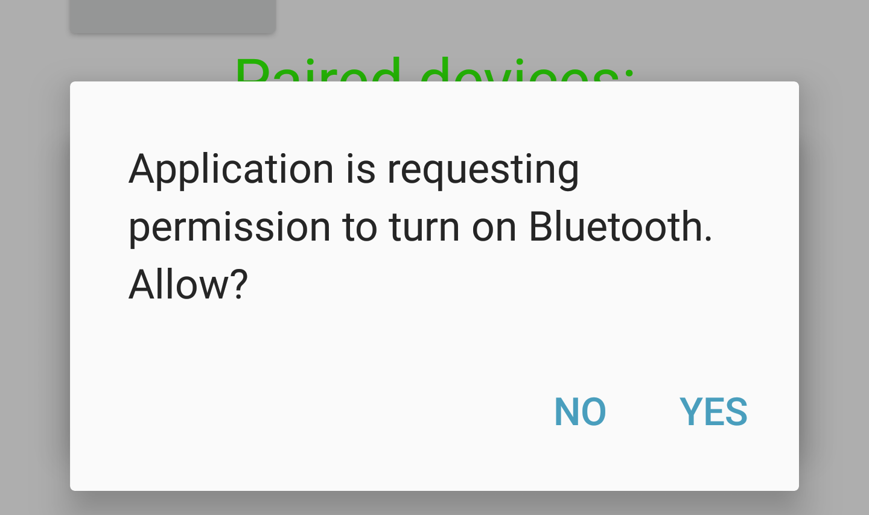
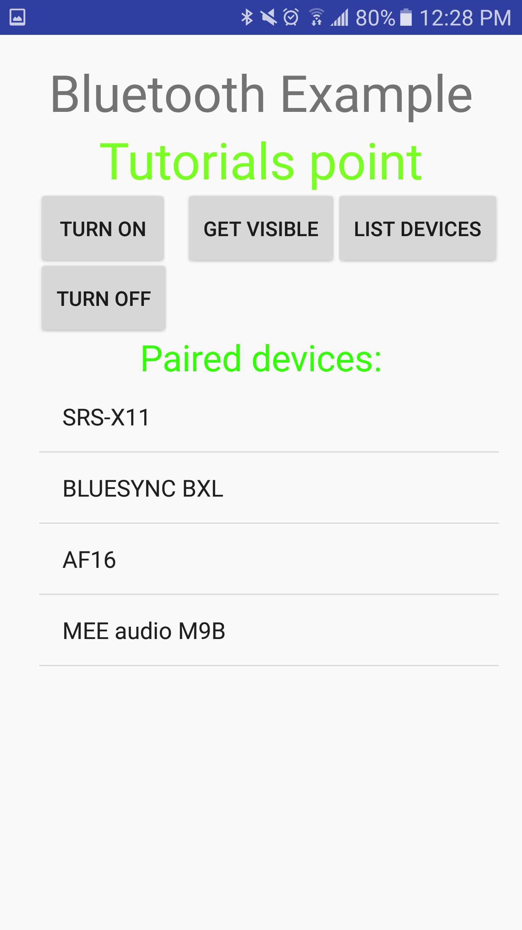
Photos of Basic Application Layout

